Slide 1
CSC 2720: Data Structures
Shiraj Pokharel

Slide 2
Attendance (Please use GSU WiFi):
https://ousp.cs.gsu.edu/seat/

Slide 3
Announcements

Slide 4
Tips specifically for GSU students
“Shiraj….I understand the concept but can’t get it into code”
Need to improve debugging skills – everyone writes bugs, but make it easier to find and fix.
Make the problematic code space smaller

Slide 5
Tips specifically for GSU students
Do more stuff outside class, it will bring the creativity and fun back into computer science
Believe in yourself. You’ll be surprised by what you can do.

Slide 6
Agenda
CS/DS/Software Engineering
Backwards Planning your CS/DS education and career
Interview Format and Typical Schedule
Proactive communication and design
Practice

Slide 7
Building a career in CS/DS
Process
Content
Communicate

Slide 8
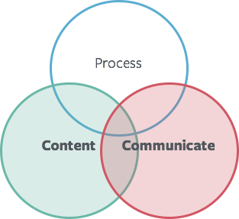
The Key to Being Successful
…is mastering the intersection of content knowledge and communication.

Slide 9
Agenda
CS/DS/Software Engineering
Backwards Planning your CS/DS education and career
Interview Format and Typical Schedule
Proactive communication and design
Practice

Slide 10

Backwards Planning
Begin with the end in mind. What is your end goal by the time you are finishing your Senior Year?

Slide 11
The goal of a software engineering…day-to-day……is to…
How you think about and tackle problems and how you communicate with code and about code.
Evaluate your problem-solving skills to see if you can translate thought into reasonably correct, well-structured code
How you consider engineering tradeoffs (time vs. memory… from DSCI 2720 : Time Complexity vs Space Complexity)

Slide 12
The goal of a software engineering…day-to-day……is to…
In software engineering as with life……. Imposter Syndrome is very real.
People have off days, and sometimes there are factors out of your control.
Keep your chin up, keep improving, and keep at it.

Slide 13
So where do I start?
Keep it simple
A foundation of data structures and algorithms
Implement, NOT memorize
After that …….?

Slide 14
So where do I start? Learn :
Keep it simple
After that …….? LEARN
Test Cases/Unit Tests
RESTful APIs
Structure Data in the Database
Packaging Code and Code Deployment

Slide 15
Learn : Source/Version Control
Git, Mercurial, Etc.
Make sure you’re confident with commits, pulls, merges, git messages, etc.
Bonus points for handling branches, grafting, stashing
Unix
Basic unix/shell commands
SSH

Slide 16
Learn : Code Diff Review
A big part of the real world is reviewing other people’s code
Typically any code has to be reviewed before being pushed to production(deployed)
Can be difficult reviewing code, especially in a new codebase!
The hard part is here not necessarily reading the code, but understanding the code
TIP : Read More code to write better code !

Slide 17
How to unblock yourself ?
Learn to read documentation, find posts in internal wikis/groups
Figure out what questions to ask, and create references for yourself (Don’t ask the same question multiple times)
Ability to be productive in a new environment is a key skill to any good Software Engineer/Data Scientist

Slide 18
Implement Data Structures and Algorithms :
Implement not memorize ☺

Slide 19
Implement Data Structures and Algorithms :
Tools to practice:
Book : Cracking the Coding Interview
The trick here is to hold yourself accountable. Lots of students ask me for ways to practice outside of class……really really ……..few actually do it.

Slide 20

Implement Data Structures and Algorithms : How to Work the Clock ?
45
Let’s Break it Down…

Slide 21
Implement Data Structures and Algorithms : How to Work the Clock ?
Let’s Break it Down…
… give yourself 5min to understand the problem
… you have 35min leftover, or 17min each
… spend 5min before you start coding
… spend ~10 min coding
… and don’t forget 2-3min for testing
…. repeat
… and leave 5min for questions
5

Slide 22
How to Work the Clock
Let’s Break it Down…
… give yourself 5min to understand the problem
… you have 35min leftover
… spend 5min before you start coding
… spend ~10 min coding
… and don’t forget 2-3min for testing
…. repeat
… and leave 5min for questions
17
17

Slide 23
How to Work the Clock
Let’s Break it Down…
… give yourself 5min to understand the problem
… you have 35min leftover
… spend 5min before you start coding
… spend ~10 min coding
… and don’t forget 2-3min for testing
…. repeat
… and leave 5min for questions
5

Slide 24
How to Work the Clock
Let’s Break it Down…
… give yourself 5min to understand the problem
… you have 35min leftover
… spend 5min before you start coding
… spend ~10 min coding
… and don’t forget 2-3min for testing
…. repeat
… and leave 5min for questions
10

Slide 25
How to Work the Clock
Let’s Break it Down…
… give yourself 5min to understand the problem
… you have 35min leftover
… spend 5min before you start coding
… spend ~10 min coding
… and don’t forget 2-3min for testing
…. repeat
… and leave 5min for questions
~2

Slide 26
How to Work the Clock
Let’s Break it Down…
… give yourself 5min to understand the problem
… you have 35min leftover
… spend 5min before you start coding
… spend ~10 min coding
… and don’t forget 2-3min for testing
…. repeat
… and leave 5min for questions
~2
5
10

Slide 27
How to Work the Clock
A few notes on rationale.
Ideally you will solve 2 problems in 45min
This gives yourself more signal to how you tackle hard problems, consider engineering tradeoffs, communicate, and better calibrate where your limits are
But it’s okay if you don’t
Even if you don’t get through 2 problems, it is ok…….. Keep Practicing

Slide 28
What tips do we have on deck for you?
It’s both an art and a science!
Communicate proactively
Design your algorithm (s) and your test cases
Work the clock
Writing code at the whiteboard
Talk through your code / solution
Handling mistakes
...the first 5’
...the next 10’

Slide 29
What tips do we have on deck for you?
It’s both an art and a science!
Test your code
Ask questions
...the last 2-3’

Slide 30
Proactive Communication
Is how you make the first 5 minutes count.
Proactive communication is any self- communication that takes place before you start coding
Intended to help you get what you need, get organized, and set the tone so that you can show what you know
Don’t let the first 5min impede the next 30min

Slide 31

Don’t start coding straight away!

Slide 32
Proactive Communication
Don’t start coding straight away!
Don’t assume problems in CS are too easy or too difficult
Repeat the questions and rephrase it in your own words
Assume all information that is given is necessary to solve problems
Ask questions!
Make sure you fully understand the problem and expected solution to return
Resolve any areas of ambiguity; clarify the scope and intention of the problem
Validate or state assumptions
If there are edge cases (inputs that could break your solution), how should they be handled?

Slide 33
For example:
You are asked to design an algorithm to sort a list.
What questions might you ask?

Slide 34
For example:
You are asked to design an algorithm to sort a list. What questions might you ask?
What sort of list? An array? A linked list?
What does the array hold? Numbers? Characters? Strings?
Are the numbers integers?
Is there an upper bound on number of elements?
Are there duplicates? Should my algorithm be stable if so?

Slide 35
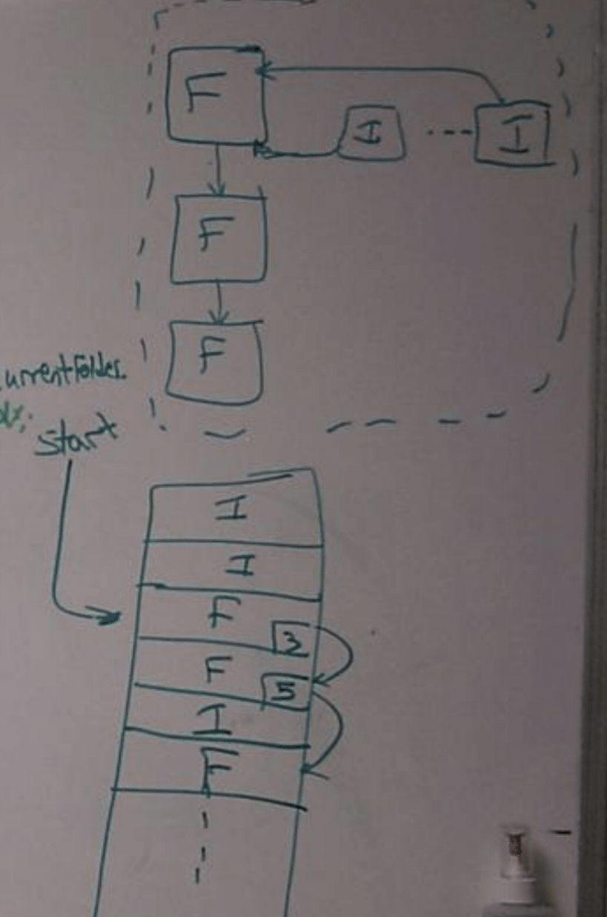
Other Forms of Proactive Communication
Remember, communication isn’t always verbal.
Be visual
Use diagrams
Illustrate the problem and your high-level solution approach

Slide 36
Don’t let perfect be the enemy of good

Slide 37
Focus on Getting a Working Solution
“Don’t let perfect be the enemy of good.”
Acknowledge the sub-optimal (brute force) solution first
Explain the time- and space-complexity of that brute force approach
Clarify why this solutions is bad – it’s unlikely this is the solution you’ll be coding
Then, consider: “Can I do better?”
Think about solutions that optimize for time- or space- complexity; consider tradeoffs
Ask …what you’re optimizing for (usually runtime or memory) and narrow down your set of solutions to the one you decide to code
Don’t worry at first about finding the MOST efficient way to solve the problem
Ask yourself: “What’s the best way to solve this that I know I can code?”

Slide 38
Algorithm Design
The Algorithm Design Manual – Steven Skiena
Elements of Programming Interviews (EPI) (available in Java, Python, C++) – Adnan Aziz, Amit Prakash, Tsung-Hsien Lee
**Cracking The Coding Interview is more beginner friendly, compared to EPI.

Slide 39
Let’s go through an example
Question:
Given an array in which every number is between 1 and N, determine if there are any duplicates.
Input: [1, 3] Output: False
Input: [2, 2, 3] Output: True

Slide 40
Given an array of numbers, determine if there are any duplicates.
Step 1 – Ask clarifying questions
Can I destroy or modify the array?
Are they all integers?
Can the array be empty?
Can I use additional space?

Slide 41
Given an array of numbers, determine if there are any duplicates.
Step 2 – Get a base solution
What’s the best way to solve this that I’m confident I can code?

Slide 42
Given an array of numbers, determine if there are any duplicates.
boolean hasDup(int[] a) { for (int i = 0; i < a.length; i++) { for (int j = i; j < a.length; j++) { if (a[i] == a[j+1]) return true; } } return false; }
O(n²)

Slide 43
Given an array of numbers, determine if there are any duplicates.
boolean hasDup(int[] a) { a.sort(); for (int i = 0; i < a.length-1; i++) { if (a[i] == a[i+1]) return true; } return false; }
O(nlogn)

Slide 44
Given an array of numbers, determine if there are any duplicates.
function hasDupe(nums) { var seen = {}; #dictionary/HashMap for (var i = 0; i < nums.length; i++) { if (seen[nums[i]]) return true; seen[nums[i]] = true; } return false; }
O(n) time and space

Slide 45
Determine if two strings are anagrams
Anagram means two strings can be rearranged to be equal
bool areAnagrams(String x, String y) {

Slide 46
Nth to Last
Given a singly linked list, find the nth to last element
If n = 1, it’s the last element
If n = 2, it’s the second to last element
4->5->1->2
N = 1 would return 2
N = 3 would return 5
Node class has fields int value and Node next

Slide 47
Nth to Last
Given a singly linked list, find the nth to last element
int nthLast(Node start, int n) {
If n = 1, it’s the last element
If n = 2, it’s the second to last element
4->5->1->2
N = 1 would return 2
N = 3 would return 5

